Slide 1


Credit Card Fraud Detection
Madhuri Basava

Slide 2
Credit Card Fraud Background
Credit Card Fraud has become a common problem in the financial sector that results in significant losses for financial institutions and cardholders.
Initially, there was physical theft of cards and forgery.
Since cards lack security features, they were the targets for fraud.
Later, the advent of magnetic stripes led to skimming and counterfeiting.
Implementation of chip technology introduced digital fraud as criminals exploited online transactions.

Slide 3
Dataset: Source
Dataset is taken from the Kaggle website: Credit Card Fraud Detection (kaggle.com)

Slide 4
Data Understanding
284807 records
No missing Values

Slide 5
Dataset: Numerical Features
There are a total of 31 features.
Time: Number of seconds elapsed between this transaction and the first transaction in the dataset.
Amount: Transaction Amount
V1-V28: Result of a PCA Dimensionality reduction to protect user identities and sensitive features.
Class: 1 – fraudulent transactions and 0 – non fraudulent

Slide 6
Questions we want to answer
Which features are most relevant for detecting fraud?
How to handle imbalanced datasets?
Which models are suitable for credit card fraud detection?
Is the model capable of detecting real-time fraudulent transactions?
What measures can be implemented to ensure the privacy and security of customer data used in fraud detection
What are the best practices for handling false positives to minimize inconvenience to legitimate users?
How can credit card fraud detection models be adapted for use in other domains such as online shopping fraud?
How does the accuracy of fraud detection models impact customer trust and satisfaction?

Slide 7
Methodology: Data Cleaning
Checked for null values. There are no null values.
Checked for duplicate values.
There were 1081 duplicates. So, I removed them.

Slide 8
Steps taken for Modeling
Load the data set into a data frame.
Perform the EDA to understand the characteristics of the data set.
Clean the data set. Remove the unnecessary features.
Evaluate the correlation between the variables in the dataset.
Apply various models to the data set.
Create a confusion matrix to show the performance of each model to evaluate the predicted values from the model vs. the actual values from the test dataset.
Calculate the accuracy for each model and choose the best model.

Slide 9
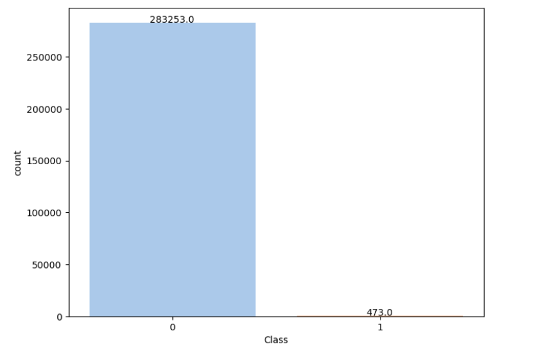
Target Distribution
From the above chart, we can conclude that only 473 of transactions are fraudulent. So, the data is highly unbalanced with respect with the target variable Class.

Slide 10
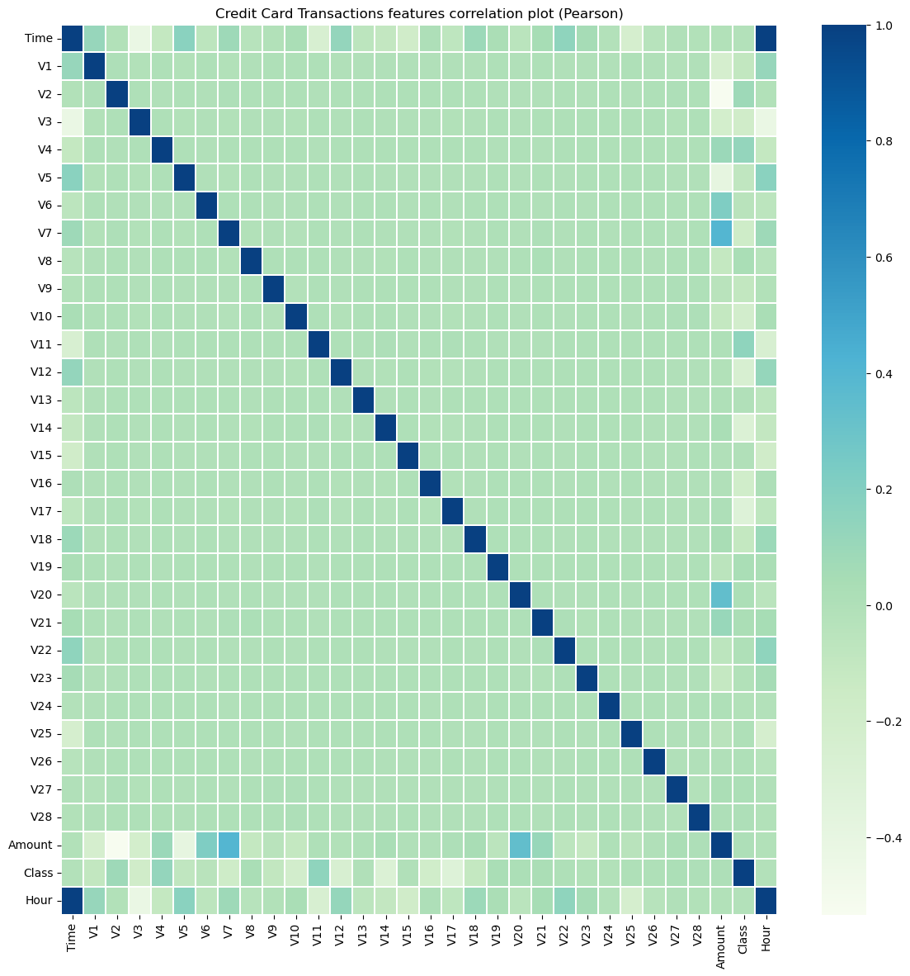
Correlation between the variables

Slide 11
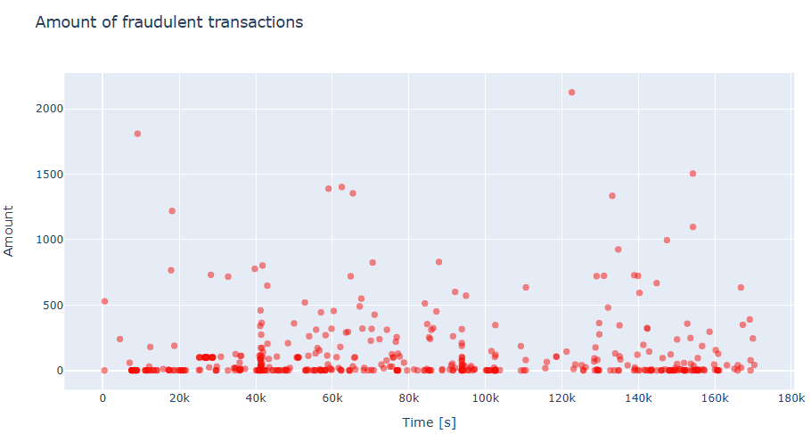
Amount of Fraudulent Transactions
The above chart depicts the number of fraudulent transactions.

Slide 12
Methodology: Algorithms
Random Forest Classifier
ADA Boost Classifier
Cat Boost Classifier
XG Boost Classifier
Logistic Regression

Slide 13
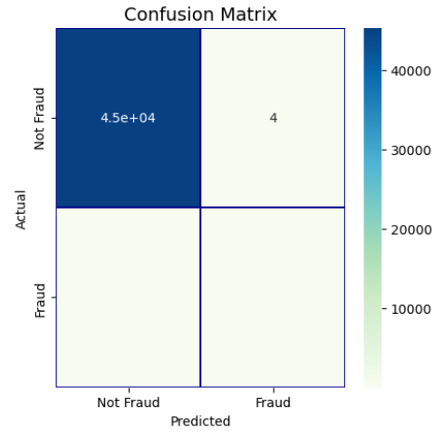
Results: Evaluation
1) Random Forest Classifier
The ROC-AUC score obtained with the Random Forest Classifier is 0.87.

Slide 14
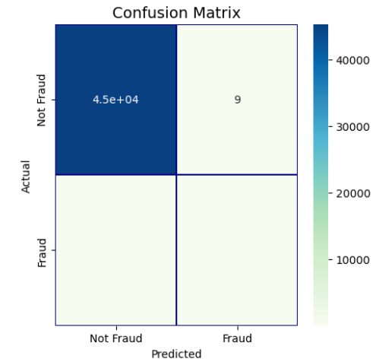
Results: Evaluation
2) ADA Boost Classifier
The ROC-AUC score obtained with the ADA Boost Classifier is 0.86.

Slide 15

Results: Evaluation
3) Cat Boost Classifier
The ROC-AUC score obtained with the Cat Boost Classifier is 0.89.

Slide 16
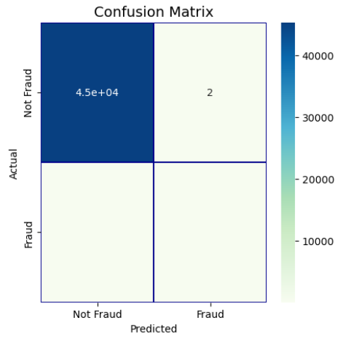
Results: Evaluation
4) XG Boost Classifier
The ROC-AUC score obtained with the XG Boost Classifier is 0.98.

Slide 17
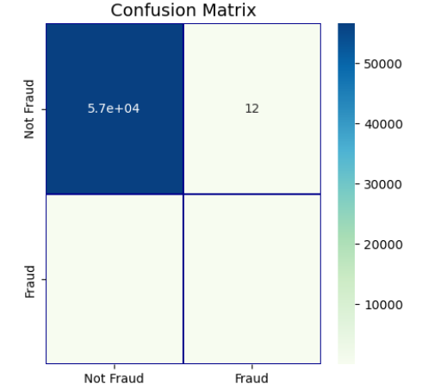
Results: Evaluation
5) Logistic Regression
The ROC-AUC score obtained with the Logistic Regression is 0.94.

Slide 18
Best Model Selection
The ROC-AUC score obtained with the Random Forest Classifier is 0.87.
The ROC-AUC score obtained with the ADA Boost Classifier is 0.86.
The ROC-AUC score obtained with the Cat Boost Classifier is 0.89.
The ROC-AUC score obtained with the XG Boost Classifier is 0.98.
The ROC-AUC score obtained with the Logistic regression is 0.94.
From the above scores, we can conclude that the XG Boost Classifier is the best Model.

Slide 19
Answers to the above questions
From XGBoost classifier, V14, V4, V17, Transaction Amount, V10, V12, V26, V3 and Time of Transaction features are important.
Using techniques like oversampling the minority class and undersampling the majority class and ensemble techniques can handle data imbalance.
Ensemble methods like Random Forest and Gradient Boosting perform well due to their ability to handle complex interactions between various features.
The model needs to be complimented with data consistency, low latency, and frameworks like Apache Kafka to detect fraud in real time.
Personally Identifiable Information (PII) data has been removed and sensitive data is masked in the non-production environments.
False Positives can be handled by providing easy ways to verify transactions, and clear communications to users that will minimize disruptions to legitimate transactions.
Existing models can be fine-tuned to detect the unique patterns and behaviors of customers in online shopping. It may need the new data injection related to online shopping and retrain the model by adjusting the parameters.
High accuracy in models can lead to a lower incidence of false positives (unnecessary transaction declines) which in turn improves customer satisfaction.

Slide 20
Conclusion
In summary, building a good credit card fraud detection system requires careful handling of data, real-time detection, and making sure the system is easy to understand and fair.
Using advanced machine learning, updating the models regularly, and protecting user data are key steps. These systems can also be used in other areas like insurance and healthcare.
Ethical concerns like avoiding bias and maintaining privacy are crucial for trust and compliance.
A strong fraud detection system helps prevent financial losses, improves customer satisfaction, and offers good returns on investment.
Regular monitoring and clear decision-making help keep the system effective and trustworthy.

Slide 21
References
The Card Fraud Detection dataset is retrieved from the Kaggle website:
Credit Card Fraud Detection Predictive Models (kaggle.com)
IEEE Credit Card Fraud Detection - EDA (kaggle.com)
Credit Card Fraud Detection Project (kaggle.com)
Credit Card Fraud Detection Guide - Best Practices & Solutions (datadome.co)
The History and Evolution of Fraud | Fraud.com

Slide 22
THANK YOU

